Slide 1
Regional Activity Centre for the SPAW Protocol
SPAW Working group sargassum tasks
joint LBS/SPAW Meeting
March, 2025

Slide 2
WG Sargassum members

Slide 3
WG Sargassum tasks
  Specific tasks, as mandated by STAC10 and decisions from COP 12:
‒ Survey Contracting Parties on their needs related to managing Sargassum influx and how such influx may affect their implementation of obligations under the SPAW Protocol and Cartagena Convention, as well as the LBS Protocol, as appropriate.
‒ Taking into account the findings of the survey and consultations, as well as any consultations with additional experts as appropriate, update and prioritize the proposed action plan of the Sargassum Working Group in UNEP(DEPI)/CAR WG.42/7 for consideration by SPAW STAC11 and COP 13.

Slide 4
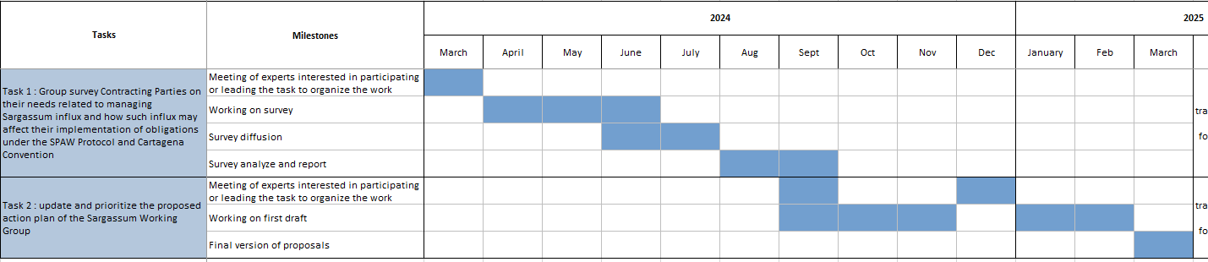
WG Sargassum timeline
10 meetings

Slide 5
Task 1
Contracting Parties needs related to managing Sargassum influx and how such influx may affect their implementation of obligations under the SPAW Protocol and Cartagena Convention, as well as the LBS Protocol-Survey analyze

Slide 6
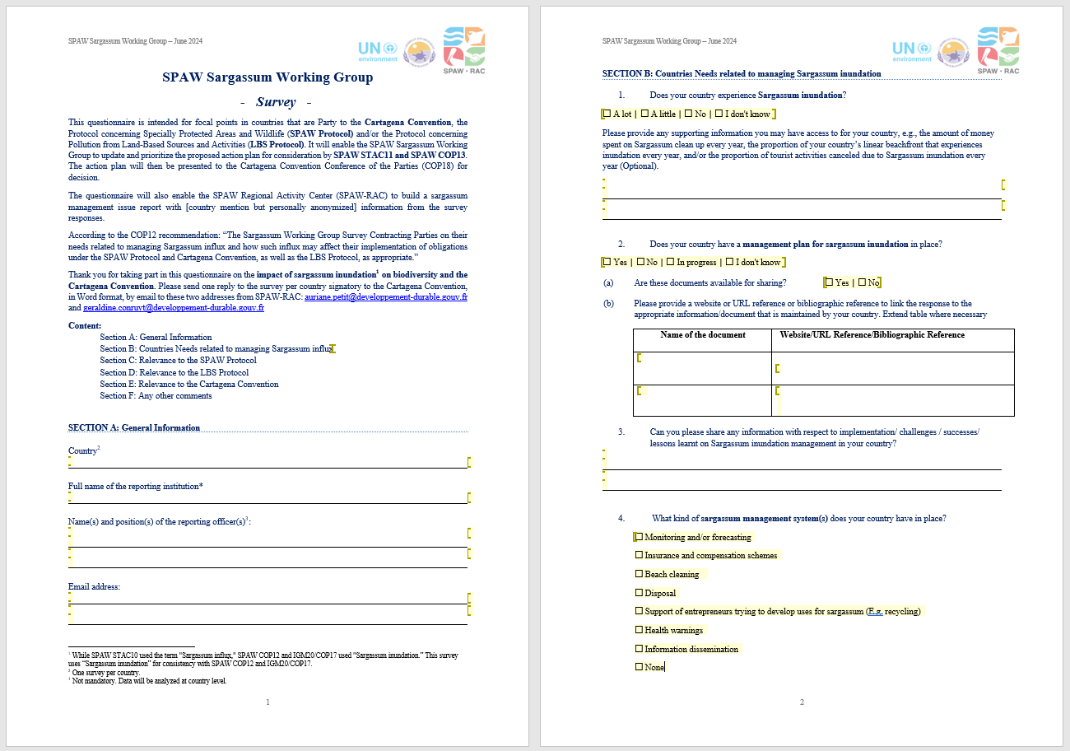
Survey
English version
(French & Spanish versions as well)
Contracting Parties consultation : June-August 2024
Section A General information
Section B Countries needs relating to Sargassum inundation
Section C Relevance to the SPAW protocol
Section D Relevance to the LBS protocol
Section E Relevance to the Cartagena Convention
Section F Any other comments

Slide 7
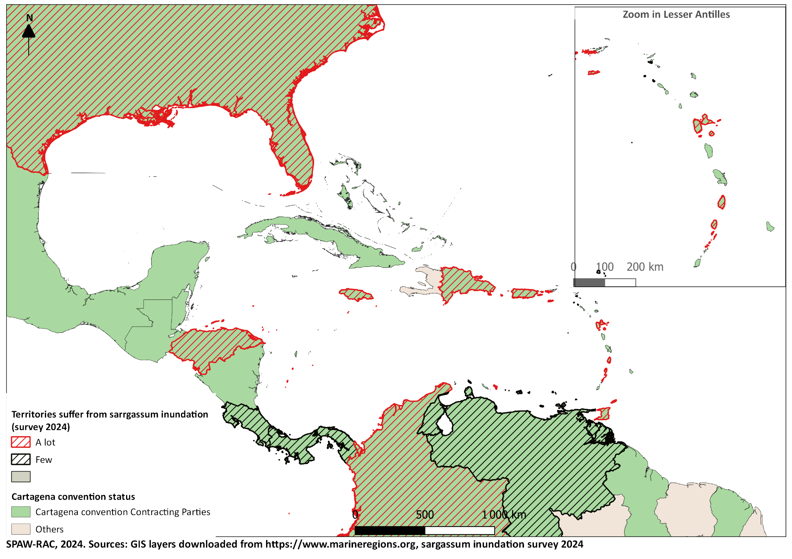
Participation report

Slide 8
Analysis methodology
Format:
It was decided that analysis should be at the smallest territorial scale possible, creating a difference in scale depending on the availability of answers (e.g. responses from Aruba, Bonaire, St Eustatius, St Maarten and Saba were considered independently, although recognising that they represent the Kingdom of Netherlands).
Technical summary of country responses to each question
General conclusion of the study targeting the major outputs.
Methodology :
1 google collaborative document
Experts assisted by SPAW-RAC collaboratively complete the document
Validation and working meetings
-Final version – end of February 2025
Credits:Braden Collum - Unsplash

Slide 9
Results
Question B1 : Does your country experience Sargassum inundation?
-heterogeneity
-countries generally report the most significant inundations on the exposed windward coasts

Slide 10
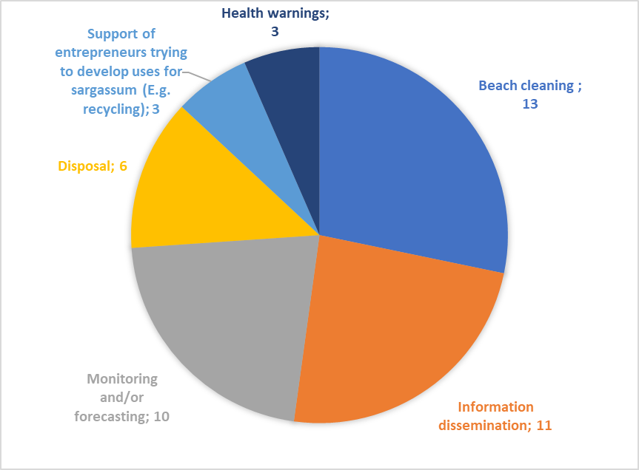
Management plans in place
-5 national MP
-1 (USA) but at states level
-3 national MP in progress MP
-but13 managements systems
-Only 3 consider that MP is effective
Major challenges :
-need coordination of management
-lack of infrastructure for sargassum management
-negative environmental impact of interventions
-limited financial resources for data monitoring, collection etc..
-need for coordination between different players, such as governments, private companies and local communities.
Topics cover by the management plans

Slide 11
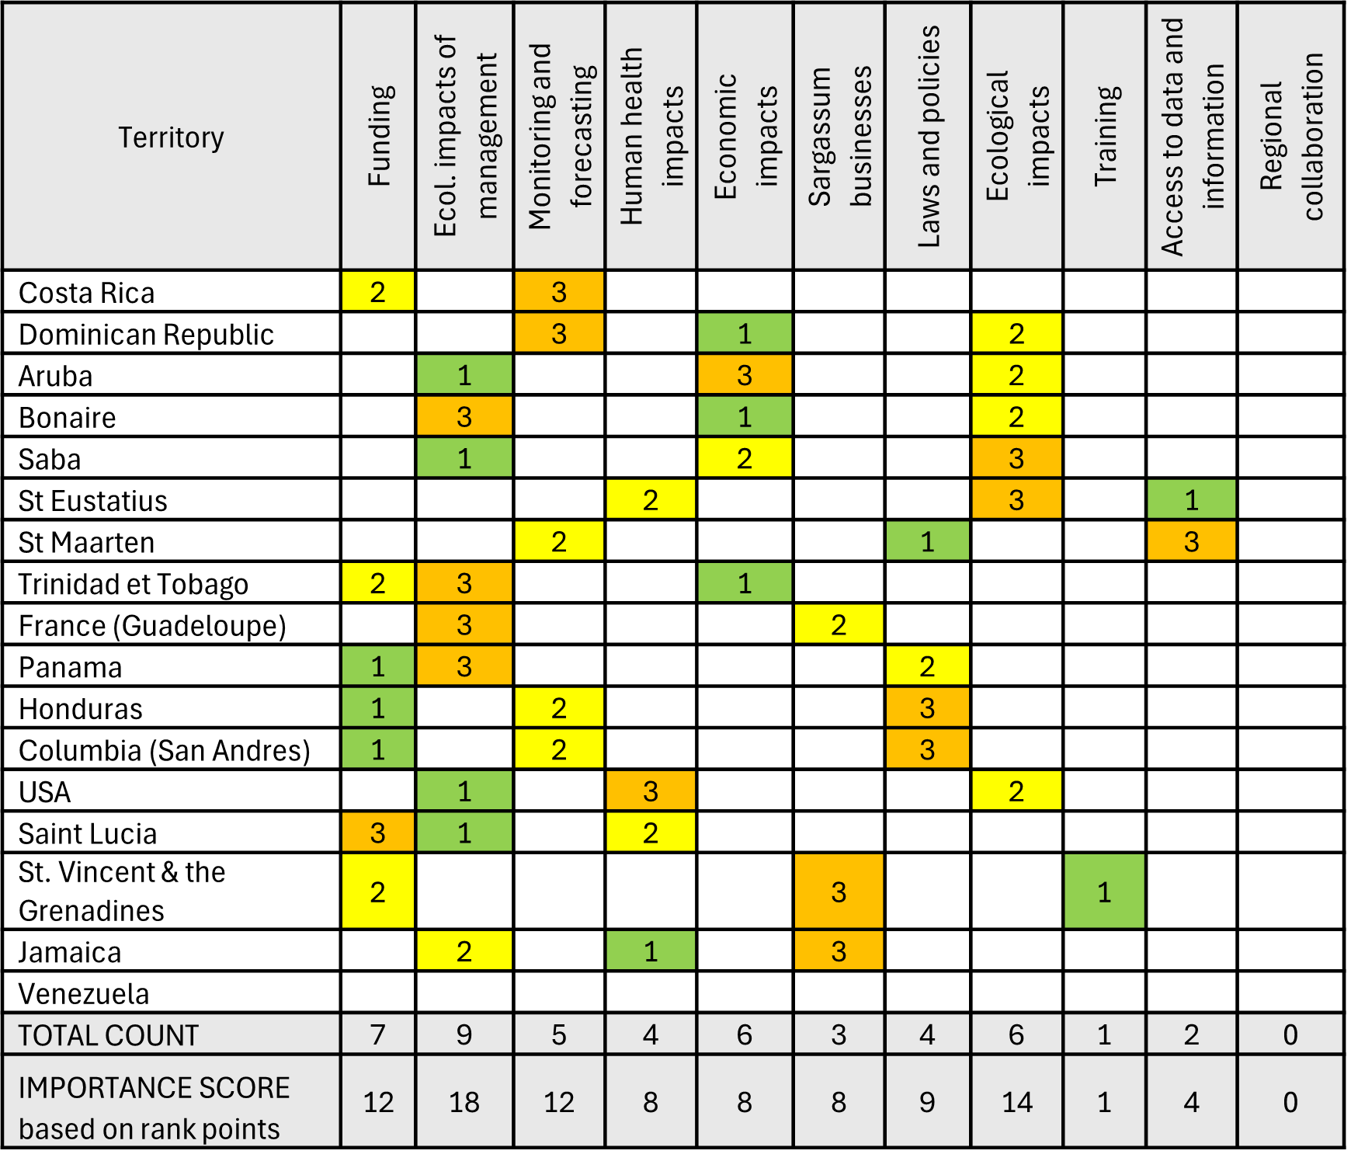
Mangement needs
1-Ecological impact of management
2-Assessing the ecological impacts of sargassum inundations
3-funding and the development of improved monitoring and forecasting of sargassum inundation events
4-Sargassum-relevant laws and the definition of legal status of sargassum
5-assessing human health, economic impacts and development of viable sargassum businesses

Slide 12
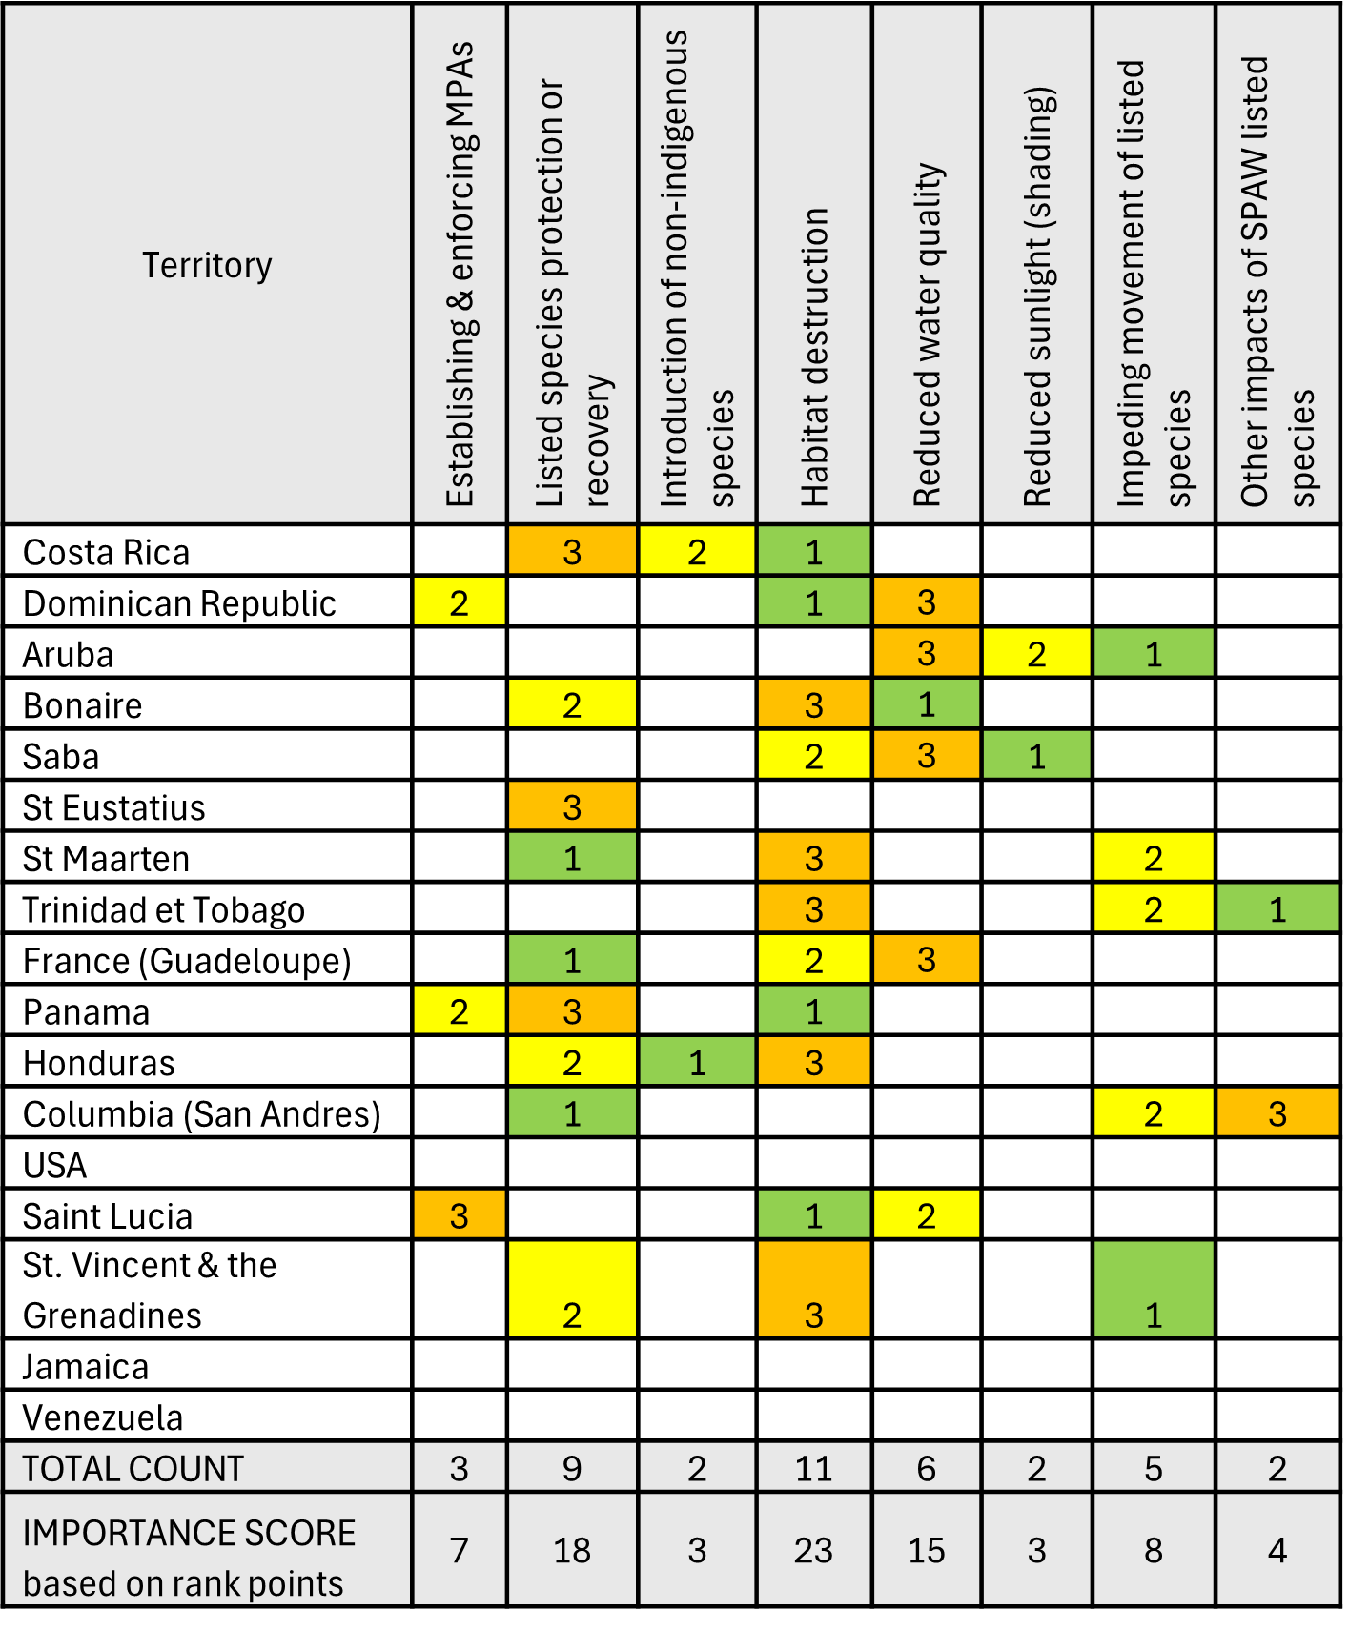
Relevance to SPAW
11 / 18 Contracting Parties responses
1-habitat destruction
2-protect or recover endangered and threatened species
3-decline in water quality
4-impeding the movement of SPAW listed species
5-Establishing and enforcing MPAs
There is insufficient information on the full impacts of sargassum inundation, leading to uncertainty regarding effects on the SPAW Protocol's implementation-lack in scientific knowledge.

Slide 13
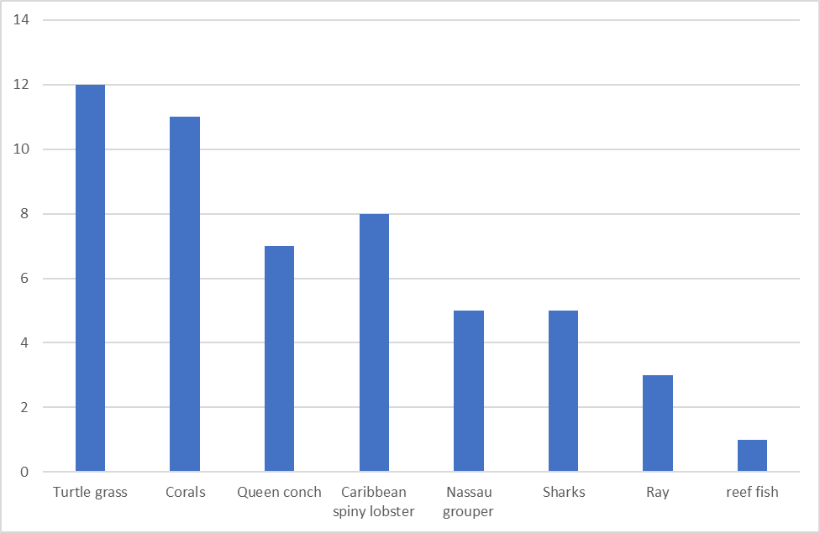
Impact on species
Sargassum inundation affects the protection and recovery of the habitats and flora listed in Annex I and fauna in Annex II of the SPAW Protocol for the majority (80%)
Especially :
-sea turtles (13)
-Corals (11)
-Birds (6)
-manatee (4)
Number of respondents reporting SPAW Annex III species (top 3) that are negatively impacted by sargassum inundations
-The lack of sargassum management plans is a problem commonly reported by several respondents hindering efforts to counter impacts on their ability to implement the SPAW protocol.
-Improve monitoring and forecasting of sargassum inundation as relevant to improving implementation of the SPAW protocol impacted negatively by sargassum inundations

Slide 14
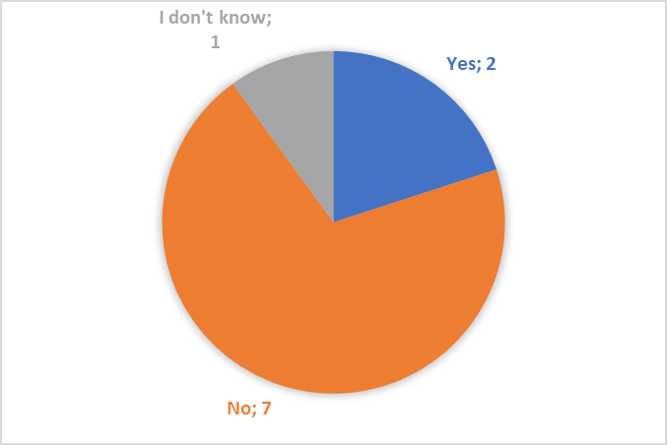
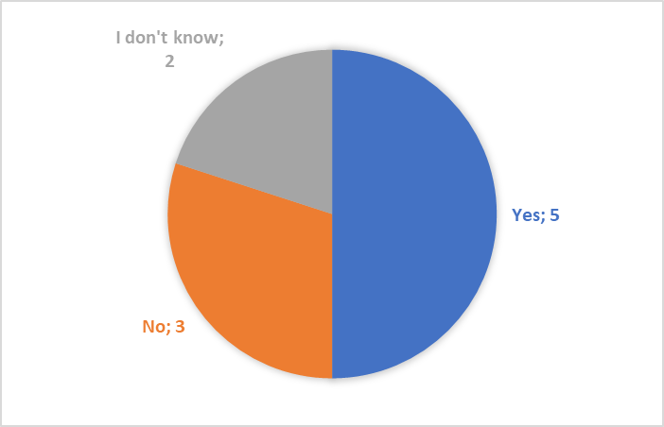
Relevance to LBS protocol
10/15 LBS Contracting Parties responses
Does sargassum inundation in your country affect how your country approaches the prevention, reduction, and/or control of pollution from land-based sources and activities?
Does your country consider sargassum should be an additional priority pollutant of concern in Annex 1 of LBS protocol?

Slide 15
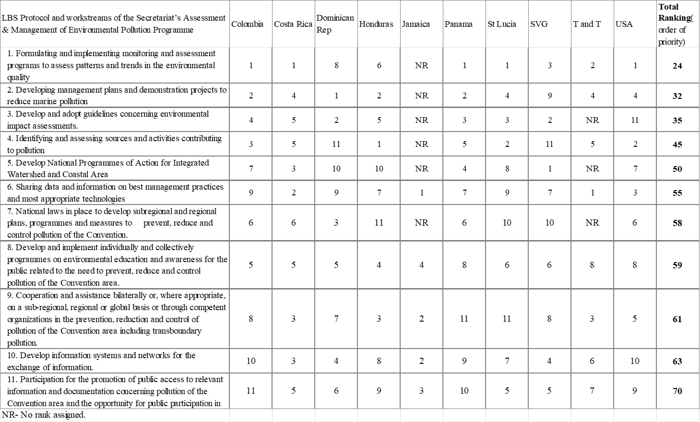
countries’ responses by order of total ranking (highest priority) of components of the LBS Protocol and workstreams of the Secretariat’s Assessment & Management of Environmental Pollution Programme

Slide 16
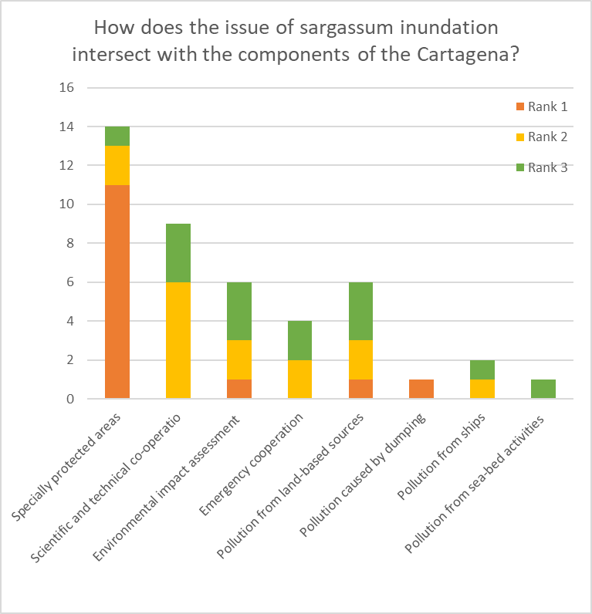
Relevance to Cartagena Convention
1-Implementation of specially protected areas
2-Scientific and technical collaboration
3-Environmental impact assessment
4-Pollution from land-based sources

Slide 17
Task 2
Action plan

Slide 18
Working method Task 2
‒ Taking into account the findings of the survey and consultations, as well as any consultations with additional experts as appropriate, update and prioritize the proposed action plan of the Sargassum Working Group in UNEP(DEPI)/CAR WG.42/7 for consideration by SPAW STAC11 and COP 13.

Slide 19
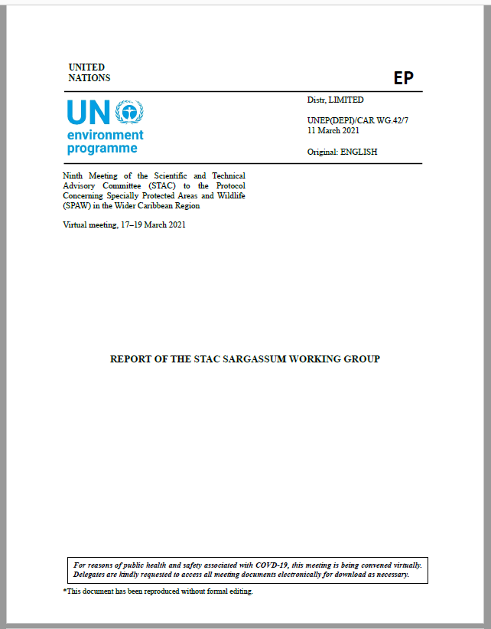
Task 2: Action Plan
Goal: Improve regional cooperation and capacity to effectively manage sargassum proliferation and coastal accumulation in the Cartagena convention marine and coastal ecosystems.
This action plan applies to the Contracting Parties of the SPAW Protocol.The Sargassum working group recommends this action plan to be presented at the next LBS STAC and COP and Cartagena IGM.
Guided by the Survey Results with inputs from the Sargassum working groups and the mandate from the SPAW STAC with the participation from LBS open-ended working group members.

Slide 20
Methodology
Format:
Table base on the previous document
Based on the survey analyze report
Methodology :
1 google collaborative document
Experts assisted by SPAW-RAC collaboratively complete the document
Validation and working meetings
Final version expected by the end of this meeting
Credits:Braden Collum - Unsplash

Slide 21
Action plan
Five components:
Governance
Research
Management
Communication and awareness
Sustainable financing resources
7 columns :
Components
Objectives
Lines of Action
Outputs
Priority
Link with the survey report
Level of action an potential funding

Slide 22

GERALDINE CONRUYT
SPAW-RAC
DEPUTY DIRECTOR
Thank you for your attention
Merci de votre attention
Gracias por su atención
geraldine.conruyt@developpement-durable.gouv.fr
www.car-spaw-rac.org

